Slide 1
Parables and Pythons
Dr. Charles “Chuck” Bell
Lesson 2: 19 September 2018

Slide 2
Class agenda
Bible Study
Introduction to the Parables of Jesus
The Golden Age of British Comedy
Spam
Computer Programming with Python
What is Computer Programming?
Basics: Input, Output, and Variables
How to use the Class Repository
Homework

Slide 3
Bible study: the parables of Jesus

Slide 4
What is a Parable?
Strictly speaking, a parable is a simple story used to illustrate a moral or spiritual lesson.
The word parable is from the root word “paraballo” or in the Greek “parabole.” This compound word comes from “para” which means “to come along side or compare” and “ballo” which literally means “to throw” or “see” with.
However, they were often told in a very different manner than what we would expect from a “story”.
May be an allegory and may include inanimate objects (like trees, plants, or things) or people in various societal positions often with a tension between good and evil.
But to understand why parables are written the way they are, we have to remember they were originally communicated orally using a specific pattern.

Slide 5
The Jewish Context
Parables are neither new to the New Testament nor are they an invention of Jesus or the disciples.
In fact, parables exist throughout the Bible.
Thus, Jesus – the “master story teller” – learned the art of parables from His Jewish heritage.
Jewish parables were often crafted specifically to “trap” the intellect causing the audience to contemplate the elements of the story.
Jesus’ parables are completely Jewish in both style and patterns of thought.

Slide 6
A Pattern for Jewish Parables
Setting – What prompts the telling of the parable – life situation or exegetical situation (Jesus’ parables tend to be situational).
Hermeneutic imagination – juxtaposition through an analogy (“life is like…”).
Mashal – a brief pattern of images or a structured story.
Nimshal – follow-up instruction or explanation of the story, analogies, or juxtapositions.
Audience – targets specific people to invoke thought, reasoning, and extrapolation of the story elements to their lives. Sometimes includes a suggest response to the story elements - the moral consequences of the story.

Slide 7
Are Parables Stories of Everyday Life?
If Jesus’ parables represented everyday life in Palestine, life must have been very strange.
A woman misplaces a small coin, spends all day searching and when she finds the coin throws an expensive late-night party to celebrate.
A woman bakes bread in a tiny clay oven, following a sacred recipe that calls for 60 pounds of flour.
A boss pays one-hour workers the same as those who work all day becoming furious when people complain.
A formal dinner party becomes packed with ”street people”.
Historical analysis shows many of these to be fictional and unrealistic for the times.

Slide 8
Jesus Gave His Parables a Prophetic Spin
His parables often used if..then parallelism to instruct future moral situations.
If anyone smacks you on the right cheek, then turn to him the other.
If anyone takes your shirt in a lawsuit, then let him have your topcoat.
If anyone commandeers you for one mile, then go two.
Jesus’ parables are often have a prophetic message wrapped up in the traditional Jewish form.
In most parables we find parallel teachings, which not only help us understand, but also help us apply the messages.
His images call us to thoughtfulness.
The messages are timeless – not tied to life of the times of Palestine, but also apply to us today.

Slide 9
Conclusion
Jesus is not the only author of parables.
Parables exist in many areas of the Bible – even the Old Testament.
Parables my be one-liners or lengthy stories.
The stories, expertly told, are timeless in their allegories.
They are also timeless in their moral guidance.
The parables of Jesus speak to us prophetically and have meaning for every Christian of every age.

Slide 10
The golden age of British comedy

Slide 11
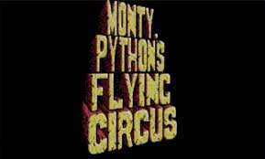
And now for something completely different…
URL: https://www.youtube.com/watch?v=anwy2MPT5RE

Slide 12
The SPAM Song Lyrics
Lovely Spam! Wonderful Spam! Lovely Spam! Wonderful Spam
Spa-a-a-a-a-a-a-am Spa-a-a-a-a-a-a-am Spa-a-a-a-a-a-a-am Spa-a-a-a-a-a-a-am
Lovely Spam! (Lovely Spam!) Lovely Spam! (Lovely Spam!) Lovely Spam!
Spam, Spam, Spam, Spam!

Slide 13
Computer Programming
Introduction to computer programming

Slide 14
What Is Programming? (1 of 2)
Programming means writing instructions to tell the computer to do a certain task.
Programming is a creative and rewarding activity. Programmers enjoy solving problems and seeing tangible results.
People write programs for many reasons, from analyzing multi-dimensional data sets to creating an interactive web page to controlling machinery.
Computers are all around us daily: laptops and cell phones are obvious ones, but computers are also found in cars, home appliances, and entertainment / personal devices.
If you have ever successfully set a ringtone on your phone, or entered an address in a GPS, or set up a game system to play, then you’ve had your first experience in programming. You’ve completed a sequence of steps to tell the computer to do a task.

Slide 15
What Is Programming? (2 of 2)
If we were to write the instructions to show someone how to set the ringtone on a phone, it would be similar to this:
Go to the phone Settings menu
Choose the Sound menu
Choose the Ringtones menu
Select the ringtone you like
Click OK to save the ringtone that you choose
The steps above are instructions that we give to our phone, the computer, to perform a task. They are equivalent to a computer program.
When someone calls our phone, the phone (the computer) follows our instructions and plays our chosen ringtone.
Similar to the “programming” example above, in this class we write instructions that tell the computer to do a specific task, and then we run the program to see the result.

Slide 16
Computer Architecture (1 of 2)
Laptops, cell phones, game systems, certain appliances… are all considered computers. So what makes a device a computer?
A computer has the following main components that are connected together:
Central Processing Unit or CPU: the “brain” of the computer. The CPU runs our instructions to do the task we specify.
Memory: stores data and instructions that the CPU uses.
Network: connects the computer to the internet.
Input / Output or IO Devices: such as keyboard, touch screen, camera, hard drive, sensor, etc.
An input device is used to enter data into the computer, such as a mouse being used to select a choice.
An output device receives data that are sent out from the computer, such as a screen that displays the result.

Slide 17
Computer Architecture (2 of 2)
The following diagram shows the basic hardware components of a computer:
We typically use an IO device such as a keyboard to enter our instructions (or our program) into the computer.
The computer stores our program and data in memory.
When the program runs, the instructions in the program are sent to the CPU, where each instruction is run or executed.
As the instructions run, the computer may access the network to communicate with remote servers (other computers).
When there are output data, the data are displayed through output devices, sent out on the network, or stored in memory.
Central Processing Unit
(CPU)
IO Devices
Network
Memory

Slide 18
Instruction Cycle
When our program runs, each instruction in our program goes through the stages of an instruction cycle:
The instruction is fetched from memory
It is decoded into a specific CPU operation and associated data
The CPU executes or performs the operation on the data
The result of the operation is stored
The next instruction is fetched from memory
It is decoded …
The cycle continues until all instructions have run.
Fetch
Store
Decode
Execute

Slide 19
The Basic Pattern
Most of our programs will use the basic pattern of
Get some user input
Perform some algorithm on the input
Provide results as output

Slide 20
Identifiers
Identifiers are names of various program elements in the code that uniquely identify the elements. They are the names of things like variables or functions to be performed. They're specified by the programmer and should have names that indicate their purpose.
In Python, identifiers
Are made of letters, digits and underscores
Must begin with a letter or an underscore
Examples: temperature, myPayrate, score2

Slide 21
Keywords
Keywords are reserved words that have special meaning in the Python language. Because they are reserved, they can not be used as identifiers. Examples of keywords are if, while, class, import.

Slide 22
Variables in Python
A variable has
A name – identifier
A data type - int, float, strings, etc. (determined by context implicitly or converted explicitly)
num = 1 + 2
num = float(25) / 2.5
Storage space sufficient for the type.

Slide 23
Integer operators
The operations for integers are:
+ for addition
- for subtraction
* for multiplication
/ for integer division: The result of 14/5 is 2
% for remainder: The result of 14 % 5 is 4
*, /, % take precedence over +, -
x + y * z will do y*z first
Use parentheses to dictate order you want.
(x+y) * z will do x+y first.

Slide 24
Python Assignment Statements
In Python, = is called the assignment operator and an assignment statement has the form <variable> = <expression>
Here, <variable> would be replaced by an actual variable and <expression> would be replaced by an expression

Slide 25
Python Assignment Statement
Syntax: <variable> = <expression>
Note that variable is on left
Semantics:
Compute value of expression
Store this as new value of the variable
Example: Pay = PayRate * Hours
10
40
400
Payrate
Hours
Pay

Slide 26
Comments
Often we want to put some documentation in our program. These are comments for explanation, but not executed by the computer.
If we have # anywhere on a line, everything following this on the line is a comment – ignored
It is always a good practice to document your code!
Not only to let others know what it does, but to remind yourself as well!

Slide 27
Input
To get numerical input from the user, we use an assignment statement of the form <variable> = input(<prompt>)
Here, <prompt> would be replaced by a prompt for the user inside quotation marks
If there is no prompt, the parentheses are still needed
Semantics
The prompt will be displayed
User enters number
Value entered is stored as the value of the variable

Slide 28
output
For output we use statements of the form
print(<expression>)
Semantics
Value of expression is computed
This value is displayed
Several expressions can be printed – separate them by commas

Slide 29
How to execute python scripts
You can use the Python interpreter or the Python IDLE application, but that has limited usability – mostly for testing statements.
Python scripts are saved in a file and executed in batch mode.
The script files are named with the .py file extension.
Example:
$ python3 ./farhenheit_to_celsius.py
Please enter a temperature in Farenheight: 99
99F == 37.22C

Slide 30
Example - Fahrenheit to Centigrade
We want to convert a Fahrenheit temperature to Celsius.
The formula is C = (F -32) x 5/9
We use type float for the temperatures.
#
# Parables and Pythons
#
# Lesson 2: Farenheit to Celsius Example
#
# This script reads a value from the user in Fahrenheit and converts it to
# Celsius
#
farenheit = input("Please enter a temperature in Farenheight: ")
celsius = (float(farenheit) - 32.0) * (5.0/9.0)
print("{0}F == {1:.2f}C".format(farenheit, celsius))
Example:
$ python3 ./farhenheit_to_celsius.py
Please enter a temperature in Farenheight: 99
99F == 37.22C

Slide 31
Computer Programming
Github

Slide 32
Class repository
All of the class files will be saved online in a special repository that you can access from home.
It uses a service called Github
URL: https://github.com/ChuckBell/Parables-and-Pythons

Slide 33
Using the Class Repository (Github)
What is Github?
Github is a code hosting and sharing website
Github, like many code hosting websites, allows for public access to code but private access to updates (can only update by invitation)
This allows for interested programmers to take part in furthering development
Why use code sharing services?
Easy to distribute work
Easy to improve on the work of others
Easy to take help from others
There are three ways to use Github.
Browse to the files and download them individually and/or view the files.
Download the files in a .zip file and extract it on your PC.
Clone the repository (advanced)

Slide 34
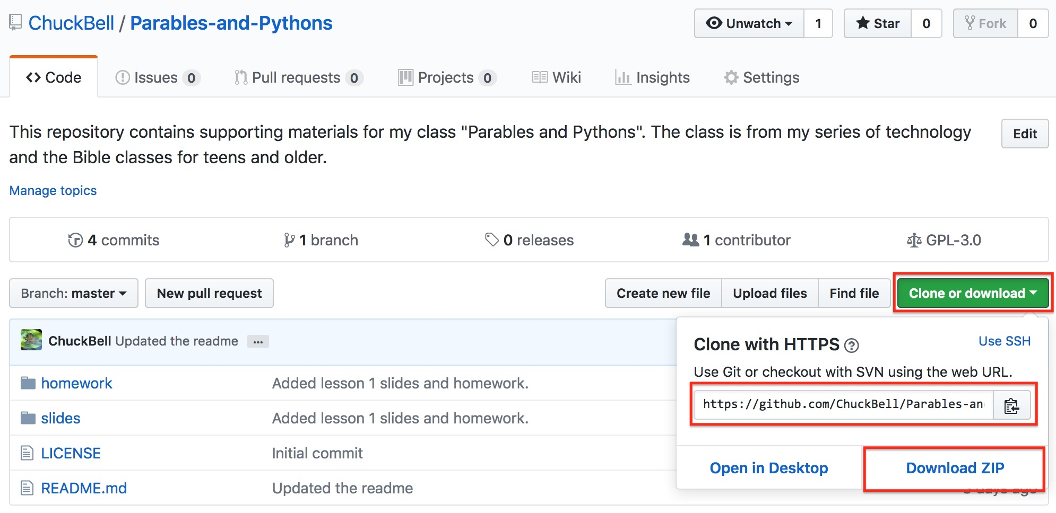
Using github: download

Slide 35
Cloning the repository
The best way to use a Github repository is to “clone” it.
This keeps an active, read-only copy of the repository on your computer.
Requires you to install “Git”, which can be downloaded from https://git-scm.com/downloads
Concepts
Clone/cloning: make a read-only copy
Pull: retrieve the latest changes
Push: send changes to the repository (restricted)

Slide 36
Cloning the repository
MacBook-Pro:~ cbell$ cd Documents/
MacBook-Pro:Documents cbell$ mkdir class
MacBook-Pro:Documents cbell$ cd class
MacBook-Pro:class cbell$ git clone https://github.com/ChuckBell/Parables-and-Pythons.git
Cloning into 'Parables-and-Pythons'...
remote: Counting objects: 17, done.
remote: Compressing objects: 100% (14/14), done.
remote: Total 17 (delta 3), reused 7 (delta 1), pack-reused 0
Unpacking objects: 100% (17/17), done.
MacBook-Pro:class cbell$ cd Parables-and-Pythons/
MacBook-Pro:Parables-and-Pythons cbell$

Slide 37
Clone the repository
Demonstration

Slide 38
Homework
All homework assignments can be handed in on hardcopy (with your name at the top) or emailed to me at drcharlesbell@gmail.com.

Slide 39
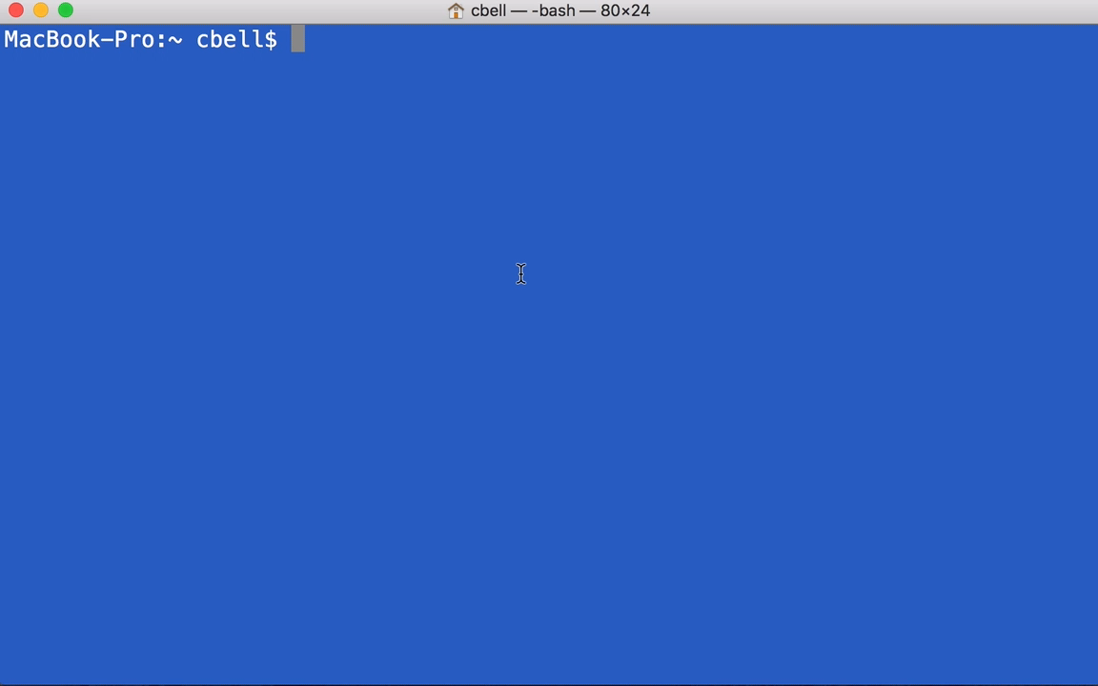
Homework #1 - Review

Slide 40
Homework assignment #2
(0 points) Download the class files from Github
(2 points) Create a file named celsius_to_fahrenheit.py to convert Celsius to Fahrenheit. Hint: you must reverse the formula. Turn in a transcript of at least 4 values converted. Hint: python ./celsius_to_fahrenheit.py.
(1 point) Install Git on your computer and clone the repository. Turn in the output of the command, “git pull”.

Slide 41
Questions or comments?

